Slide 1


Website Analytics
Group 8
Group Members:
Harsh Vardhan Pande
Surabhi Prashant Thakar
Pranav Madhukar Sathe

Slide 2



Web Analytics Background
Data Cleaning Process
Discretization
SMOTE
Classifier Selection
Experimental Design
Summary and Conclusion
Notes:
Our roadmap starts from the Background about web analytics, including information about backdrop of the company from where the dataset is obtained. Next steps involves Data cleaning and discretization that are further accurate using Smote technique. Later part of our presentation gives the detail information about the classifier selection and experimental design thus forming up our Summary and Conclusion with points to be kept in mind for future scope.

Slide 3
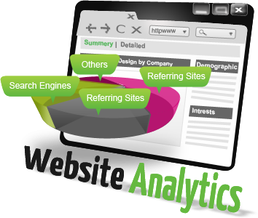
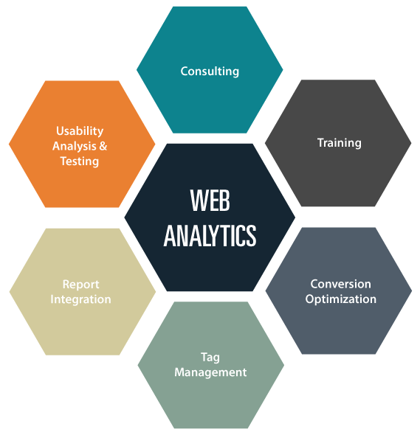
What is Web Analytics?
The Digital Revolution:
Personal computers and smartphones put the ability to access, modify, store and share digital media in the hands of billions of people
Web analytics is the measurement, collection, analysis and reporting of web data for purposes of understanding and optimizing web usage
Notes:
Web analytics is not just a process for measuring web traffic but can be used as a tool for business and market research, and to assess and improve the effectiveness of a website. It helps one to estimate how traffic to a website changes after the launch of a new campaign. Web analytics provides information about the number of visitors to a website and the number of page views.

Slide 4
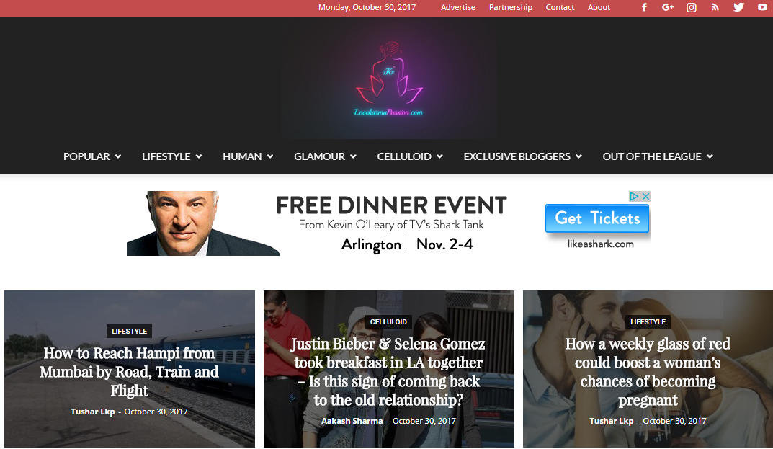

Data Background
Our dataset comes from lifestyle brand company that deals in publishing articles about lifestyle on digital platform.
Notes:
In today’s fast pacing, highly competitive,volatile and challenging world, companies highly rely on data analysis obtained from both offline as well as online way to make their future strategy, to sustain in the market.

Slide 5
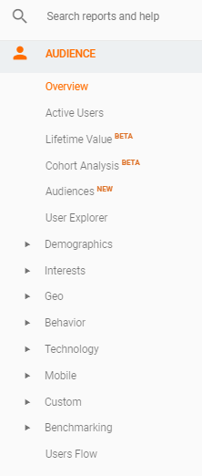
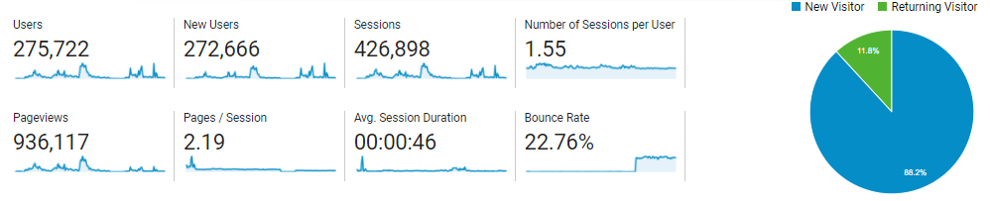
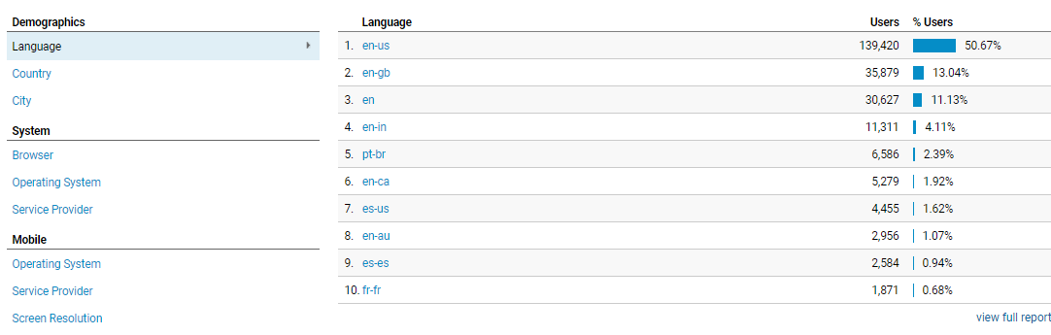
Data Background – Backdrop of the company
Notes:
Last decade and specially last 5 years has seen a tremendous growth in the number of companies going online for Lifestyle, Fitness and Health Care related articles on digital platform. There is a cut throat competition among companies for (i) first acquiring the market share and then(ii) retaining their prospective customers.

Slide 6
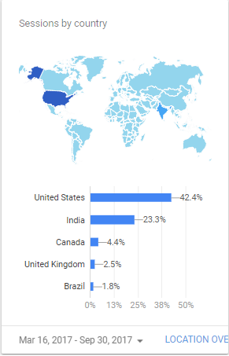
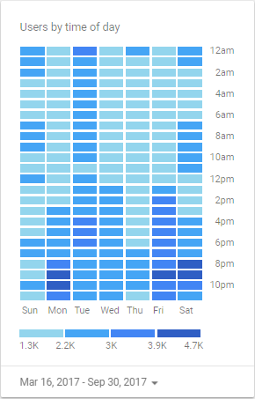
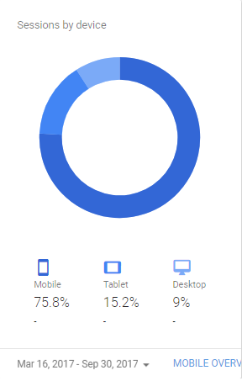
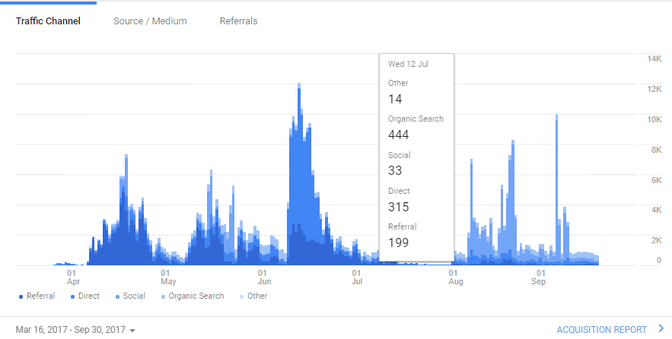
Data Background – Backdrop of the company
How do we acquire users?
Digital Media is numerical, networked and interactive system of links and databases that allows us to navigate from one bit of content or web page to another.
Notes:
As this is the data which on correct analysis is supposed to take theses companies forward, while wrong interpretation of the data can be fatal for the companies also.

Slide 7
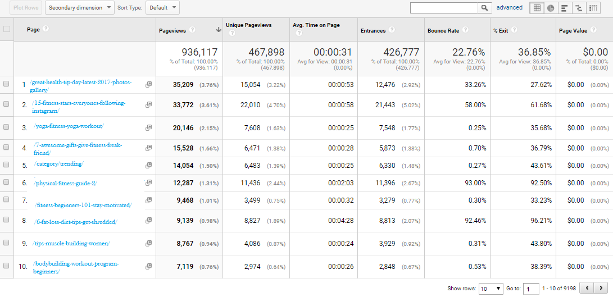
Data Background – Behavior Overview
Notes:
The web analytic reports are informative enough to provide the various dimensions on which company had been working and the quantitative value of the goal which company needs to achieve.

Slide 8
Classification Model
Page URL
Unique Page Views
Avg. Time on Page
System
Page Views
Bounce Rate
Entrances
% Exit

Slide 9
Data Background – Dataset and Attributes
Attribute Name | Descriptions
Page URL | The pages visited, listed by URI. The URI is the portion of a page's URL following the domain name; for example, the URI portion of www.example.com/contact.html is /contact.html.
Page views | Pageviews is the total number of pages viewed. Repeated views of a single page are counted.
Unique Page Views | Unique Pageviews is the number of sessions during which the specified page was viewed at least once. A unique pageview is counted for each page URL + page Title combination.
Avg. Time on Page | The average amount of time users spent viewing a specified page or screen, or set of pages or screens.
Entrances | Entrances is the number of times visitors entered your site through a specified page or set of pages.
Bounce Rate | The percentage of single-page sessions in which there was no interaction with the page. A bounced session has a duration of 0 seconds.
Exit % | %Exit is (number of exits) / (number of pageviews) for the page or set of pages. It indicates how often users exit from that page or set of pages when they view the page(s).
1st Day | The total number of pageviews for each URL over the initial period of 24 hours over 1st day.
10th Day | The total number of pageviews for each URL over the final period of 24 hours over 1oth day.
(1-10 days) total | Sum of the total number of pageviews for each URL over the initial period of 10 days, day 1 till the 10th day.
(11-20 days)total | Sum of the total number of pageviews for each URL over the period of next 10 days from 11th till the 20th day.
(1-10days)% change | Percentage change of page views over the initial period of 10 days, day 1 till the 10th day.
(11-20 days)% change | Percentage change of page views over the period of next 10 days from 11th till the 20th day.
Notes:
Using the above assumptions and the data set provided by the company following were the input and output variables determined for the current system .
Explain the derived attributes

Slide 10
Data Background – Class attribute
Main objective is to find out the attributes directly responsible for the Page views.
Pageviews reflect the interest level of users, narrows down the chance for predicting future movements. Thus, finding the best relationships based on attributes for the companies.
Thus, our class attribute is the Percentage Change of Page Views in 11-20 Days.

Slide 11

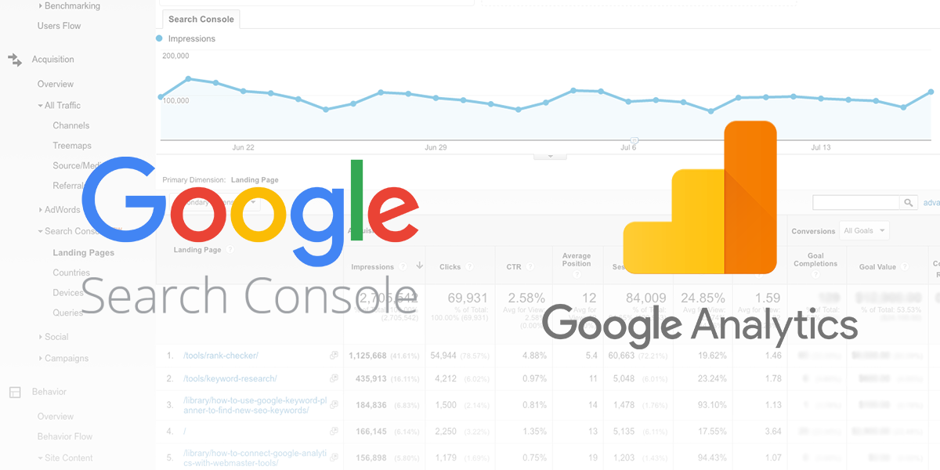

Data Cleaning Process: Tools used
We used two tools:
Google Analytics
Google Search Console
Microsoft Excel

Slide 12
Data Cleaning Process
Irrelevant attributes, Missing values, derived attributes
1.Dealing with errors:
Replaced #DIV/0!with 0.
2. Irrelevant Values:
Page Value*: Removed attribute
The average value of this page or set of pages. Page Value is ((Transaction Revenue + Total Goal Value) divided by Unique Page Views for the page or set of pages))
Removed “”, ‘’.

Slide 13
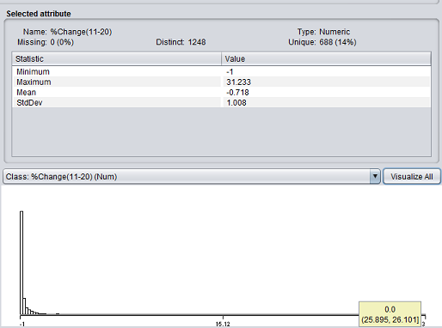
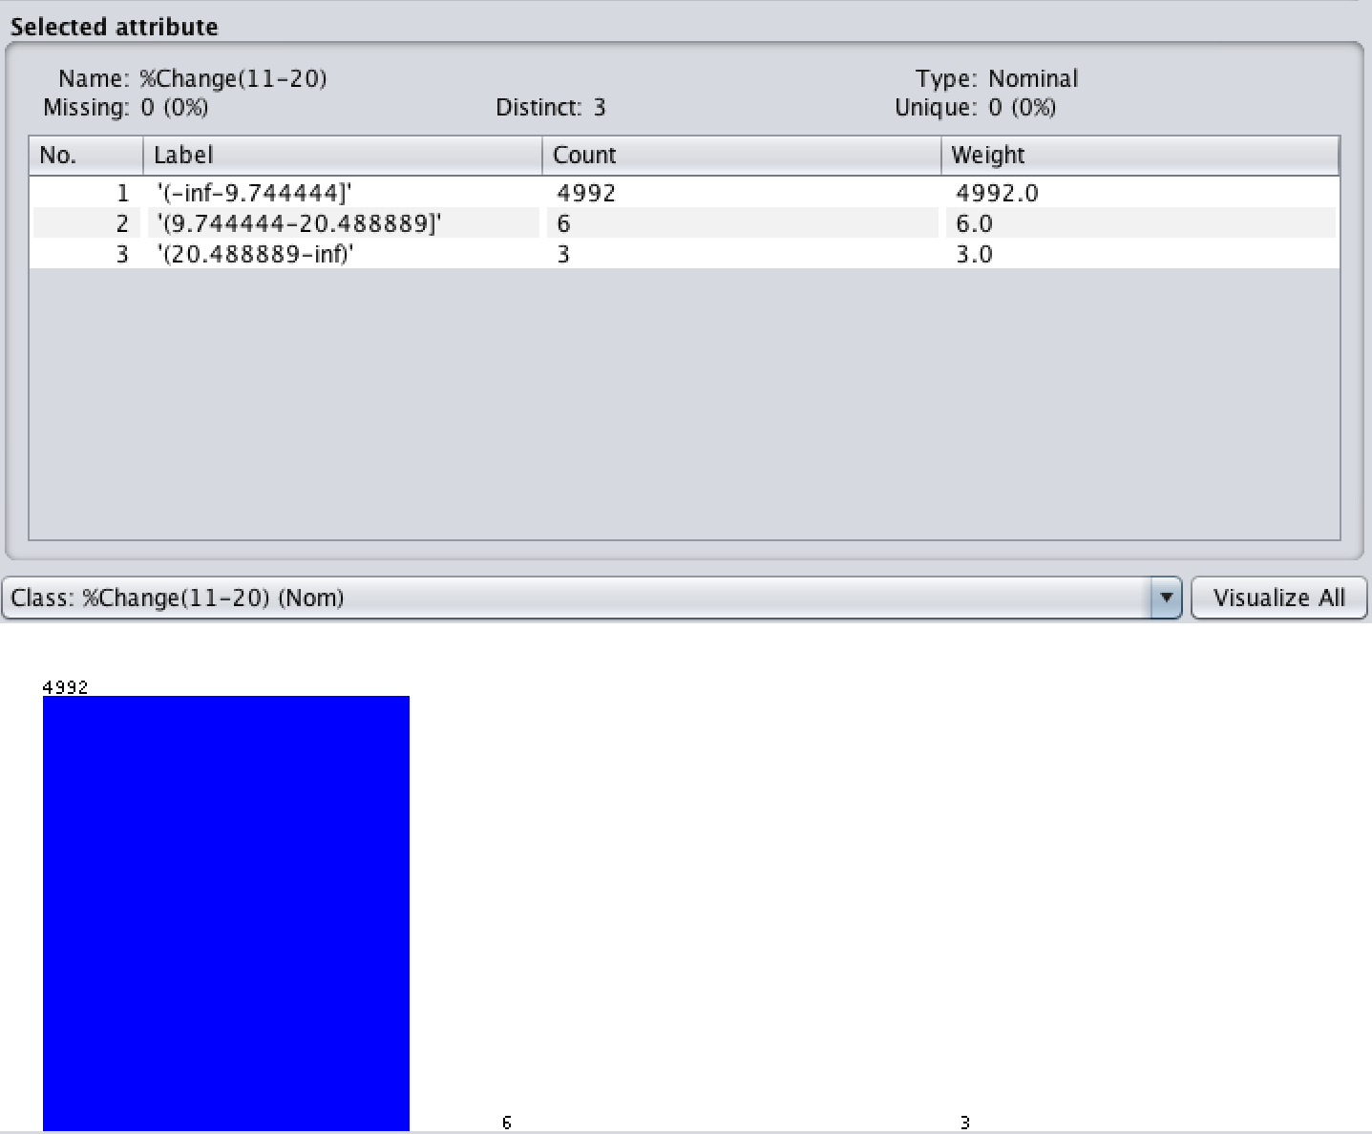
Discretization
Before Discretization After Discretization
Notes:
For performing classification algorithms on our data-set, we require the class attribute to be nominal. Our dataset had a numeric class attribute ,hence we used discretization (3 bins) to convert it to nominal.

Slide 14
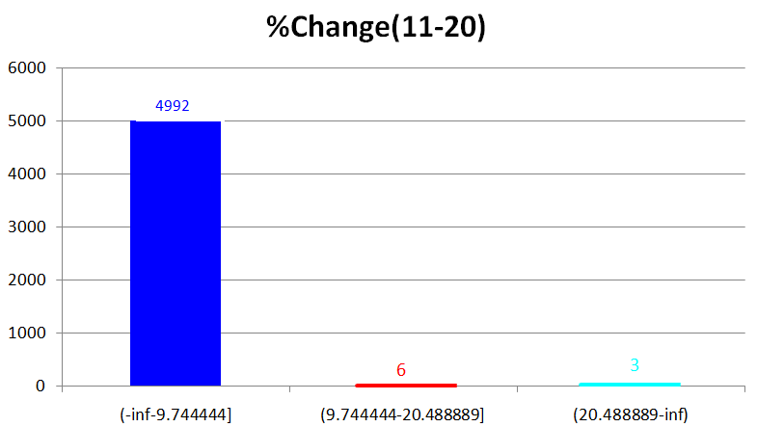
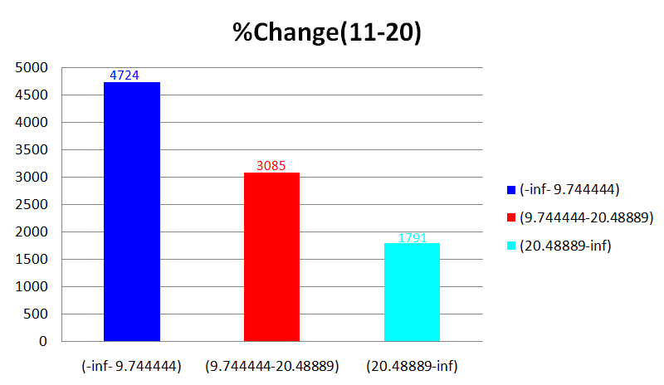
SMOTE Technique

Slide 15
False Predictors
We have used two methods to determine false predictors in our data set:
1) Domain analysis: Our domain analysis brought out two false predictors in our cleaned data set:
1st Day
10th Day
2) Attribute accuracy
using OneR:
Attribute | Accuracy
With Page URL | 99.37%
Without Page URL | 73.31%

Slide 16
Classifier Selection
OneR
01
Naive Bayes
02
J48
03
JRip
04

Slide 17
Experiment Design: Four cell experiment design
Two Factor Design:
Our experiment design contained of two factors:
1. Factor 1 (F1) : Noise
2. Factor 2 (F2) : Percentage Split

Slide 18
Experiment Design: Four cell experiment design
Four Criteria of the Design: The two factors are to be divided up into 4 criteria by keeping one factor constant and varying the other factor between two values and vice versa.
Factors | No noise | With noise (10%)
Percentage Split (20%/80%) | C1 | C3
Percentage Split (80%/20%) | C2 | C4
Notes:
Total number of experiment runs = Number of criteria * Number of Classifiers * 10 = 4 * 3 * 10 = 120 runs

Slide 19
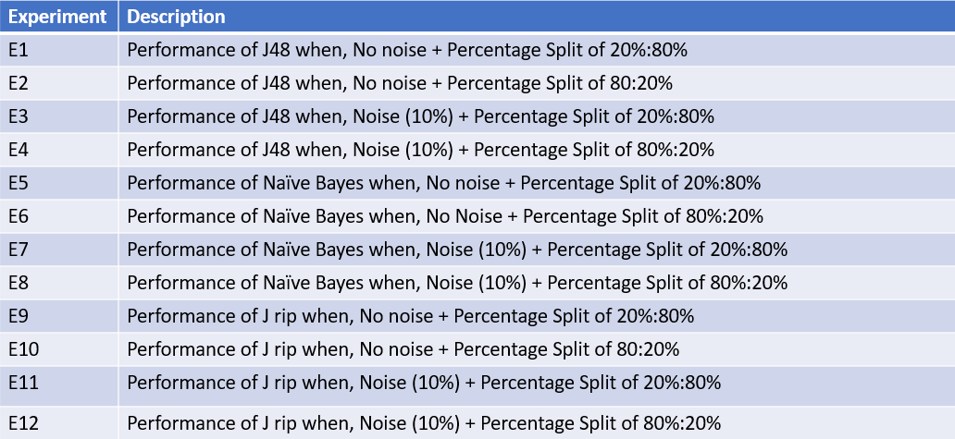
Description of Experiments Conducted

Slide 20
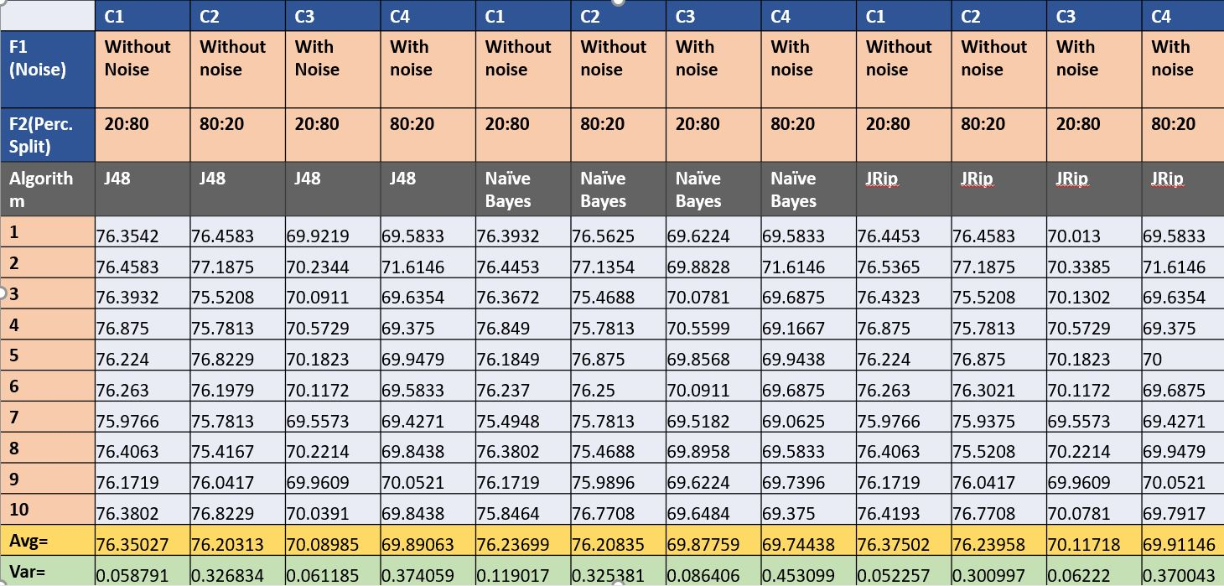
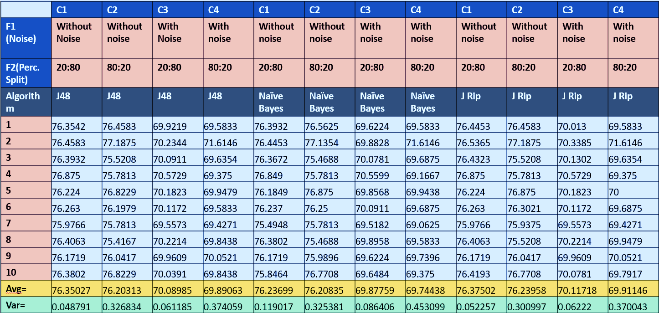
Experiments Results

Slide 21

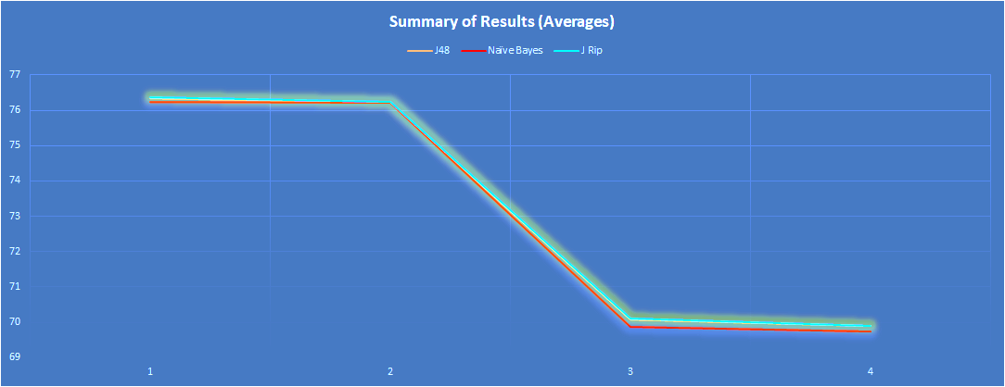
Summary of Results: Averages
Notes:
graph using 0.5 scaling will give better view our average graph.

Slide 22
Summary of Results: Averages
Summary of Averages | C1 | C2 | C3 | C4
J48 | 76.35027% | 76.20313% | 70.08985% | 69.89063%
Naïve Bayes | 76.23699% | 76.20835% | 69.87759% | 69.74438%
JRip | 76.37502% | 76.23958% | 70.11718% | 69.91146%
Here, as expected, C3 and C4 perform relatively poorly.
This is due to the introduction of noise in the data (class variable).
JRip provides the best performance among all the classifiers used to train data with an accuracy of 76.37502%
J48 comes second with a similar but slightly lower accuracy.
Our third classifier Naïve Bayes performs poorly compared to other algorithms.

Slide 23
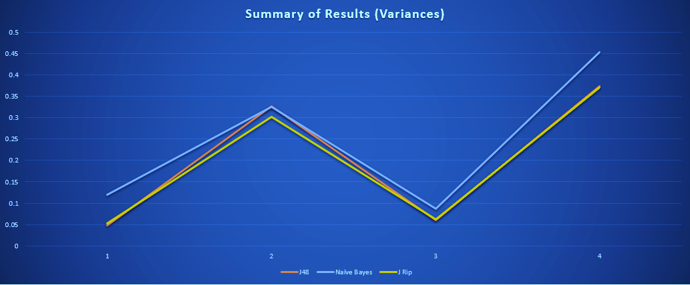
Summary of Results: Variance

Slide 24
Summary of Results: Variance
Summary of Variances | C1 | C2 | C3 | C4
J48 | 0.058791 | 0.326834 | 0.061185 | 0.374059
Naïve Bayes | 0.119017 | 0.325381 | 0.086406 | 0.453099
JRip | 0.052257 | 0.300997 | 0.06222 | 0.370043
As shown in the graph above, JRip has the lowest variance in a no noise – 20:80 percent split environment.
The Naïve Bayes has the highest variance among all three algorithms in the presence of noise.
The Naïve Bayes has the highest variation among all classifiers from C1 to C4 ; That is, the Naïve Bayes is the least stable among all three classifiers.
The Naïve Bayes classifier varied 5 times between C3 and C4 i.e.: in the presence of noise.

Slide 25
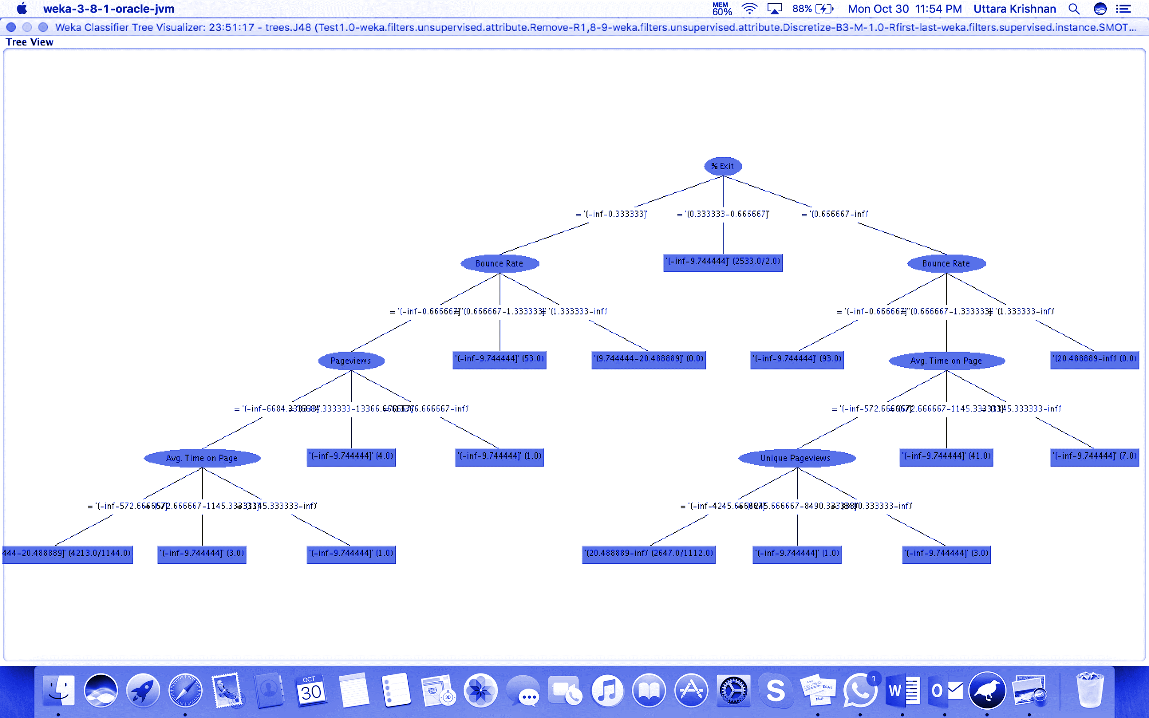
Weka Results
1) J48 :Decision Tree

Slide 26
Result
2) Jrip
Rule Set Obtained:
Rule1:
(% Exit = '(0.666667-inf)') and (Bounce Rate = '(0.666667-1.333333]') and (Avg. Time on Page = '(-inf-572.666667]') and (Unique Pageviews = '(-inf-4245.666667]') and (%Change(1-10) = '(-inf-51.6]') => %Change(11-20)='(20.488889-inf)' (2645.0/1110.0)
Rule2:
(% Exit = '(-inf-0.333333]') and (Bounce Rate = '(-inf-0.666667]') and (Pageviews = '(-inf-6684.333333]') and (Avg. Time on Page = '(-inf-572.666667]') and (%Change(1-10) = '(-inf-51.6]') => %Change(11-20)='(9.744444-20.488889]' (4211.0/1142.0)
Rule3:
=> %Change(11-20)='(-inf-9.744444]' (2744.0/2.0)

Slide 27
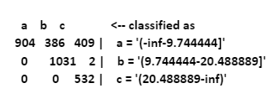
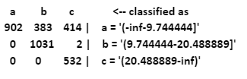
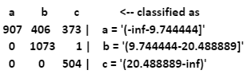
Result
Confusion Matrix
J48
Naïve Bayes
JRip

Slide 28

Conclusion
Data mining on real time web data and was a sincere attempt to answer some questions from a company growth perspective.
Averages and Variance: Best Technique
Page Views formula(Ruleset) for Company Growth
Inference: User’s all across are generating page views reading articles online but to make it grow exponentially in future, the Company needs to concentrate more on strategies focusing % Exit, Bounce Rate, and Avg. time on page attributes.

Slide 29

Future Scope
One very important challenge this analysis pose to us is to find a suitable model to mine the information for comparison purposes based on Page Views.
We further plan to use regression technique, as the nature of the data is numeric and then compare the results with classification algorithms and see if we can come up with better results.

Slide 30
References
https://www.youtube.com/watch?v=P--UFzlNGeA- Weka Tutorial 06: Discretization (Data Preprocessing)
https://en.wikipedia.org/wiki/Weka_(machine_learning)
http://www.cs.put.poznan.pl/jstefanowski/sed/DM-6rulesnew.pdf
http://web.ydu.edu.tw/~alan9956/docu/refer/roc_introduction.pdf
https://analytics.google.com/analytics/web/?authuser=1#report/content-pages

